Slide 1
2023 Leadership Orange
Operations Division
December 15, 2023

Slide 2
Operations Division Introduction
Safety and Emergency Management
Building Code Compliance
Environmental Compliance & Sustainability
Procurement Services
Transportation Services
District Police
Food & Nutrition Services

Slide 3
Florida Sterling Award

Slide 4
Safety and Emergency Management
Joe Silvestris, Sr. Director

Slide 5
Safety and Emergency Management
PORTFOLIO
Office of Emergency Management
Organizational Resilience and Continuity of Operations
Office of Fire Marshal
Fire Prevention and State of Florida Requirements for Educational Facilities
Office of Occupational Safety and Health

Slide 6
Safety and Emergency Management
Office of Emergency Management:
Build organizational resilience to adverse events, business disruptions and emergencies
Lead district-wide business continuity, disaster recovery and emergency management programs
Coordinate district's response of critical incidents and emergencies to include on-scene operational support
Develop comprehensive emergency management and business continuity plans and procedures
Develop and provide standardized emergency preparedness training programs
Plan, coordinate and deliver emergency preparedness drills and exercises
Manage the district's Emergency Coordination Center
Provide direct support to schools ensuring readiness and resilience
Collaborate with emergency management and public safety partners

Slide 7
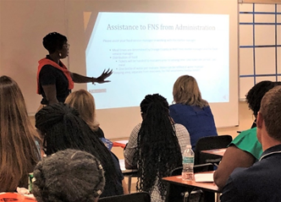
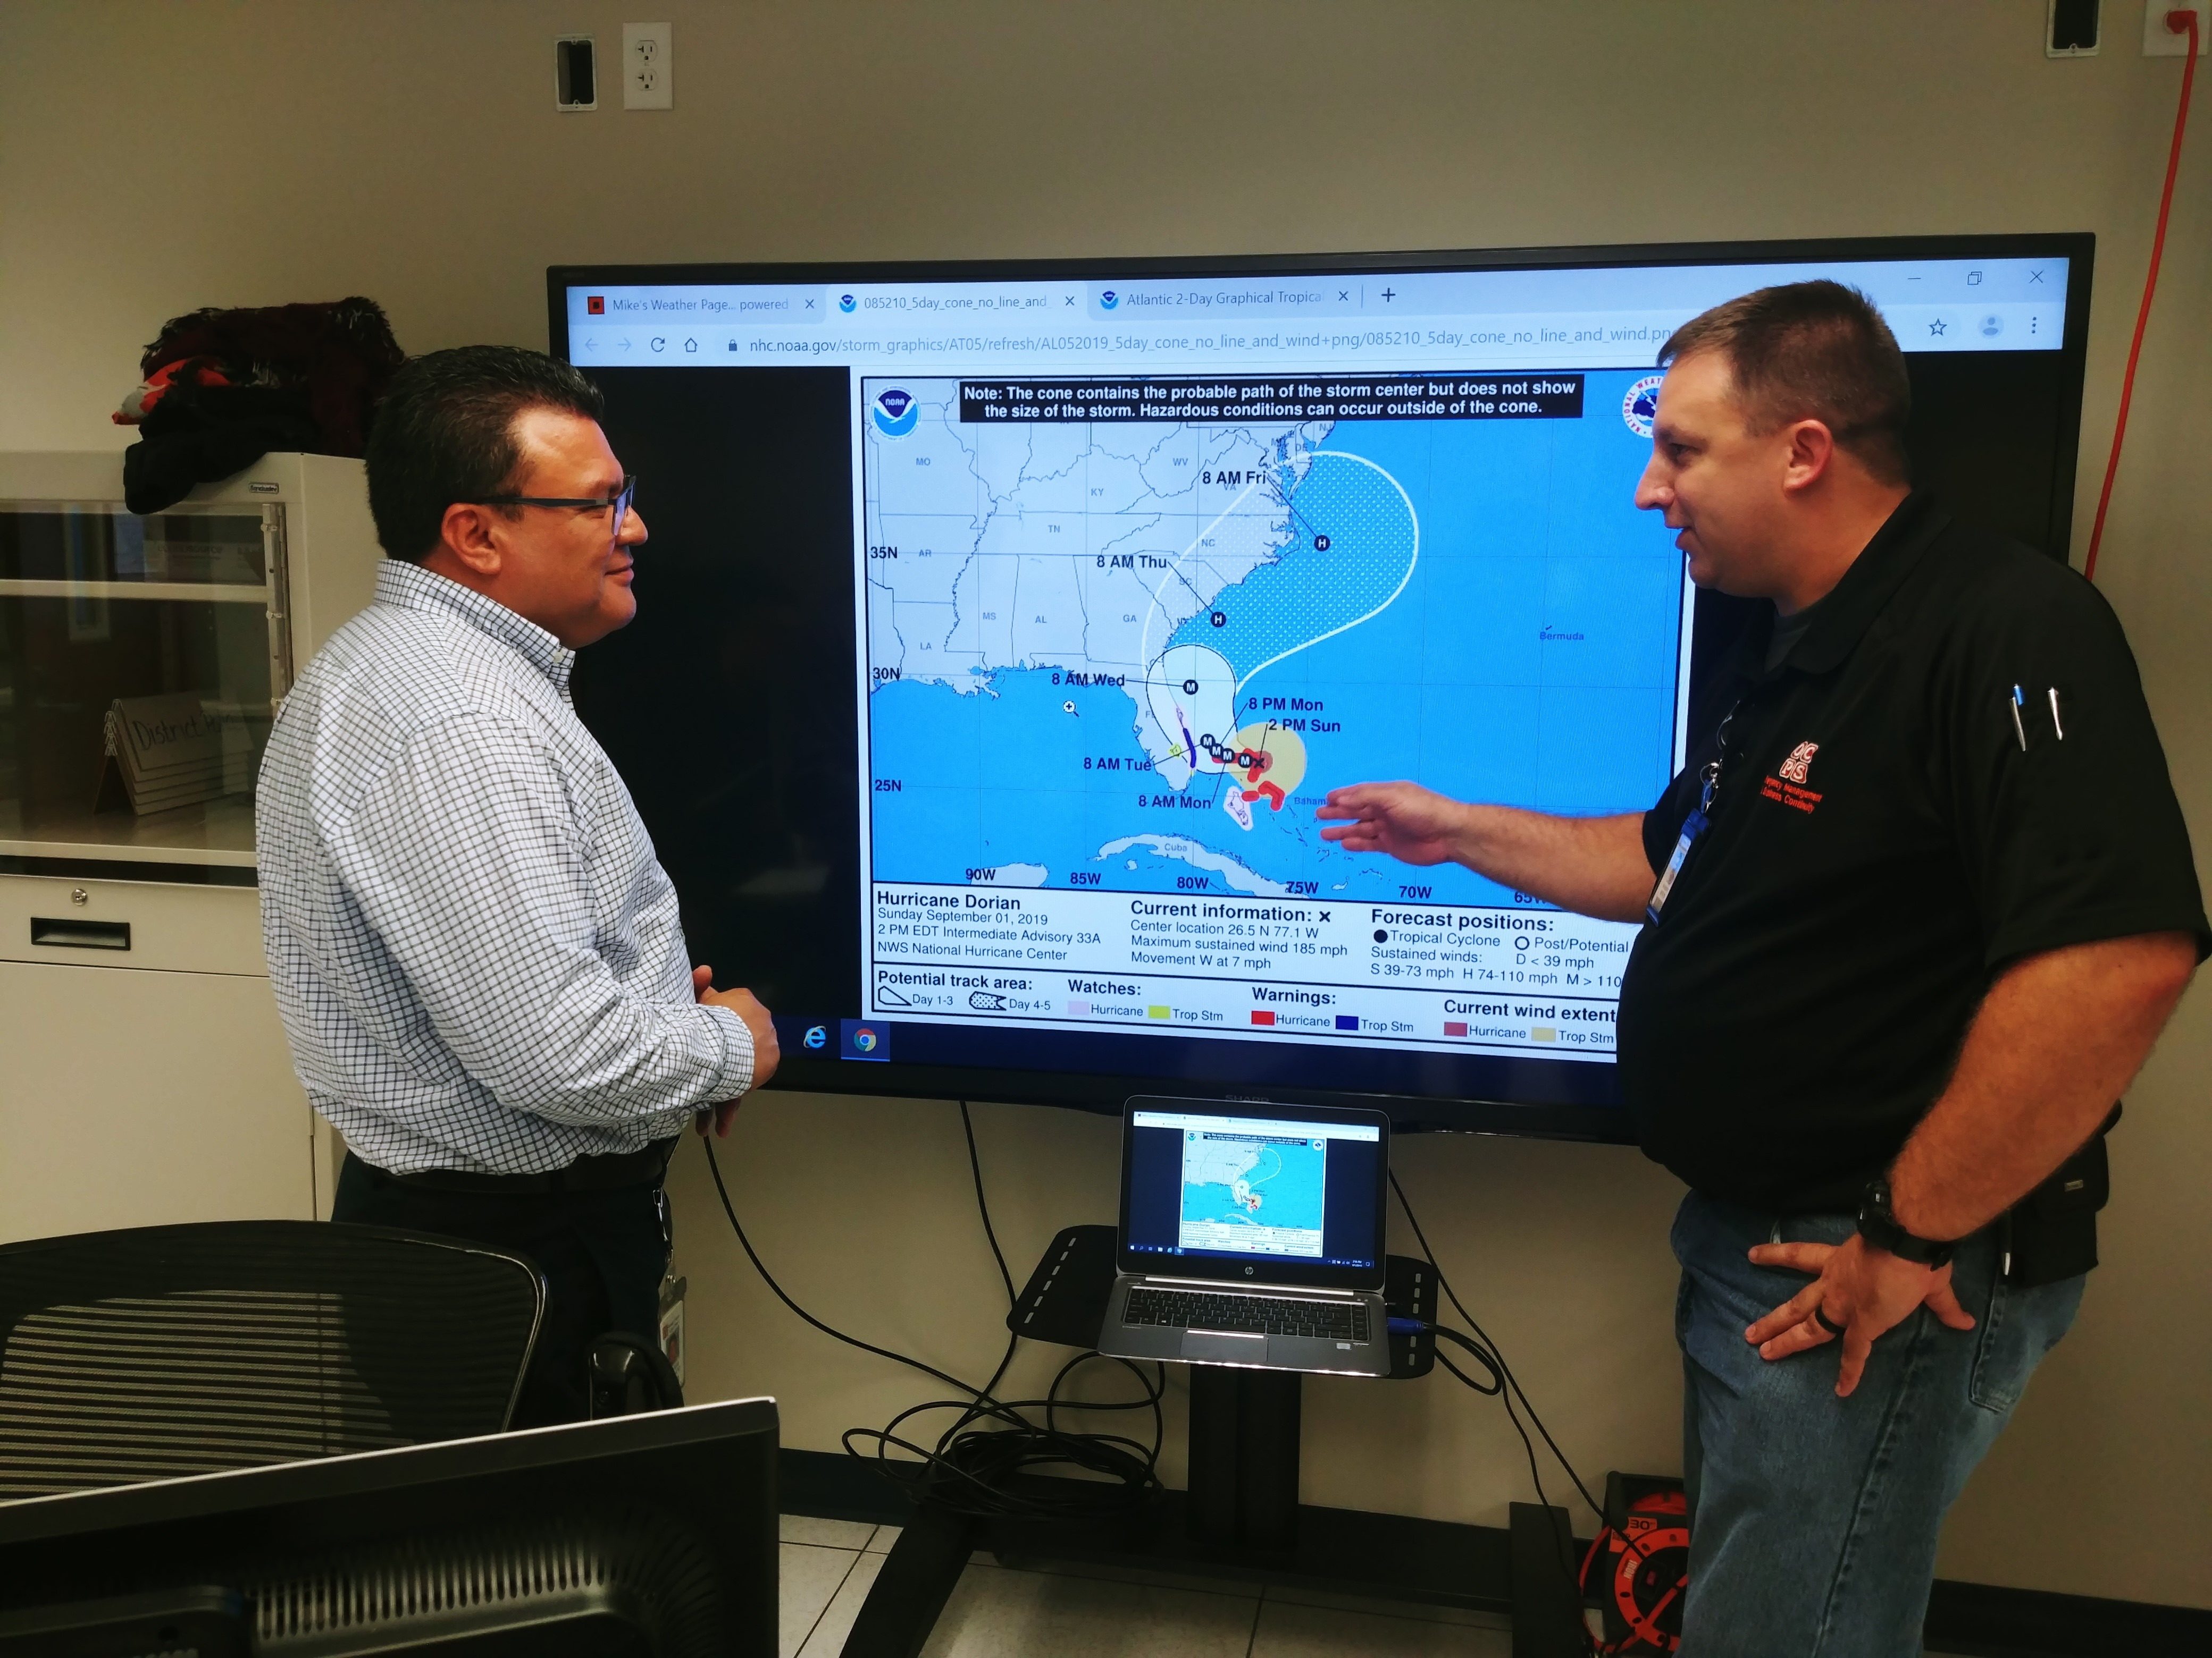
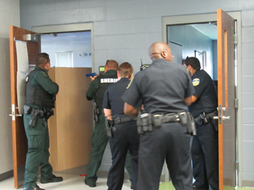
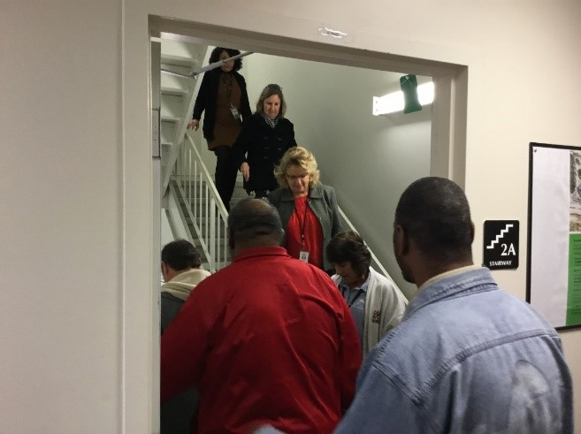
Safety and Emergency Management
Office of Emergency Management
Over 1,000 training and exercises conducted across all school campuses​
Over 4,000 drills completed across all campuses​
Preparedness Days:
Three-day conference style training and exercise event for school administrators​
Over 1,000+ administrative site employees trained in emergency procedures ​
Recognized as a StormReady school district by National Weather Service, Melbourne​

Slide 8
Safety and Emergency Management
Office of Fire Marshal
Create a culture of safety through the reduction of fire and life safety risks
Enforces compliance with the Florida Fire Prevention (FFPC) and oversee fire safety administration
Interpret fire and life safety codes to ensure compliance throughout district
Conducts fire and life safety inspections to promote a safe environment and reduce risks
Reviews construction plans and specifications for compliance with applicable fire and life safety codes
Conducts FFPC and State Requirements for Educational Facilities (SREF) compliance inspection services
Oversees all fire protection and detection systems compliance
Applies proactive prevention-based measures to reduce exposure to fire and life safety risks
Investigates fires of suspicious/unknown origin and/or those involving a fatality/injury to determine cause
Manages relationships with fire departments to ensure well-coordinated fire prevention/response services

Slide 9
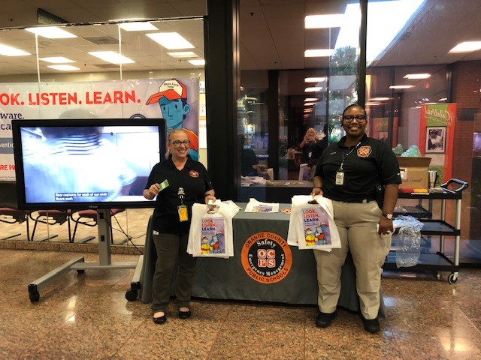
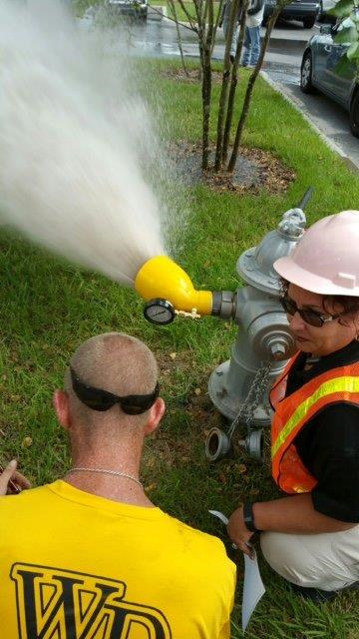
Safety and Emergency Management
Office of Fire Marshal
Annual Comprehensive Facilities Inspections (ACFI) of all OCPS sites, which constitute over:
3,000 buildings
20,000+ classrooms
33,000,000 square feet of space
664 ACFI inspections and re-inspections
6097 new construction/capital renewal projects reviewed
1707 construction project inspections

Slide 10
Safety and Emergency Management
Office of Occupational Safety & Health
Create a culture of safety through the reduction of health and safety risks
Applies proactive prevention-based measures to reduce the district’s exposure to operational health and safety risks
Coordinates compliance, inspection and reporting activities related to health and safety codes, regulations and statutes
District’s emergency life-saving measures program (i.e., AED, bleeding control kit, trauma kit, etc.)
Responsible for pedestrian and traffic safety program (i.e., SafeWalk Program, etc.)
Works closely with Risk Management Department in mitigating risk reduction (i.e., Injury Prevention Task Force, etc.)
Collaborates with external partners and regulatory agencies on issues of mutual interests

Slide 11
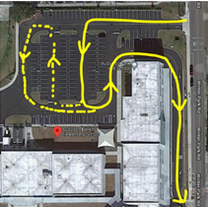
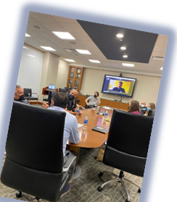
Safety and Emergency Management
Office of Occupational Safety & Health
Led 79 pedestrian and traffic safety assessments (SafeWalk)
75% recommendation adoption rating
Oversees OCPS’s Automated External Defibrillator (AED)
Tracks 534 AEDs throughout the District.
Trained 2000+ employees using virtual Hands-only CPR/AED awareness program
Created the Injury Prevention Task Force to lower occupational injury rates and reduce Workers’ Compensation costs

Slide 12
Building Code Compliance Office
Gerard Cattani, Director

Slide 13
Building Code Compliance Office

Slide 14
Building Code Compliance Office

Slide 15
Building Code Compliance Office
Enforces all Florida Building Codes and identified design standards
Enforces applicable Florida Statutes including State Requirements for Educational Facilities
Performs construction document code reviews for building, electrical, fuel gas, mechanical, plumbing, accessibility, energy conservation, fire alarm systems and fire sprinkler systems as required by Florida Statute
Performs all required construction inspections at all Orange County Public School facilities
Issues all permits, Certificates of Occupancy and Certificates of Construction Completion for all new construction, renovation and maintenance projects
Notifies the Board, through a letter to Facilities Design and Construction, when submitted construction documents are building code compliant

Slide 16
Building Code Compliance Office
Tasks performed through a process of the following:
Accepting and processing applications for permits
Reviewing construction documents submitted for code compliance
Issuing construction permits once approved
After permits are issued, field inspections of the work are conducted to ensure the project is constructed, in accordance with the approved plans
At completion of the project, if all inspections have passed, a Certificate of Completion or Occupancy is issued

Slide 17
Building Code Compliance Office

Slide 18
Building Code Compliance Office
How many architectural plan & change order reviews were conducted during the last fiscal year?
3,650
How many construction inspections were conducted during the last fiscal year?
5,551
How many certificates of construction completion or occupancy were issued during the last fiscal year?
1,123
What was the inspection passing rate for last fiscal year?
92%

Slide 19
Building Code Compliance Office
As a cost savings measure, BCCO has implemented a virtual inspection program
With the utilization of FaceTime and Skype, certain types of inspections are conducted from office computers

Slide 20
Environmental Compliance & Sustainability
Jennifer Fowler, Sr. Director

Slide 21
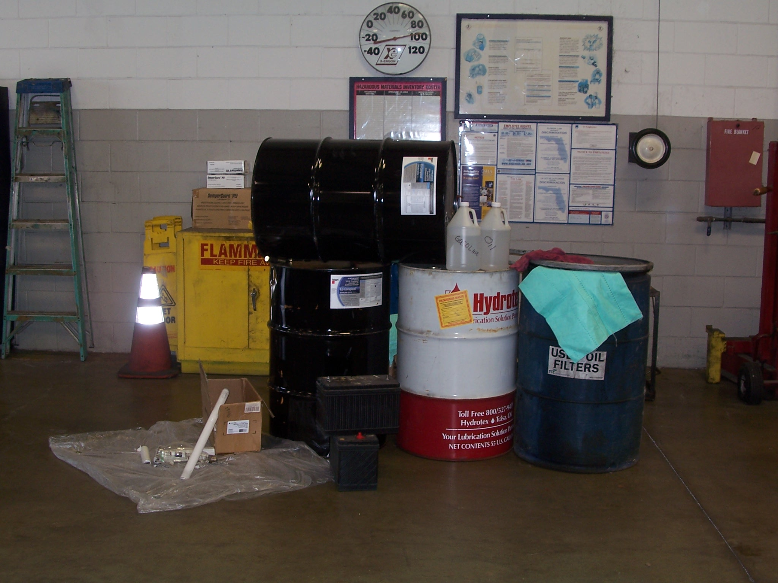
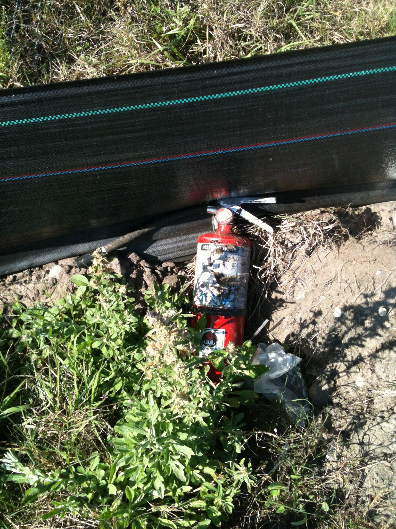
Environmental Compliance & Sustainability
Monitors conditions to comply with standards dictated by environmental regulatory agencies
Monitors conditions of active construction sites for environmental regulatory compliance and verify documentation is being maintained
Provides a single point of contact for regulatory agencies
How many employees were trained in the 2020-2021 school year?
800
How many construction site inspections were conducted?
52

Slide 22
Environmental Compliance & Sustainability
Managed Programs:
Hazardous waste
Universal waste (fluorescent bulbs, ballasts, and batteries)
Petroleum waste
Biomedical waste
Pharmaceutical waste
Indoor environmental quality (IEQ)
Asbestos
Lead in drinking water
Lead-based paint

Slide 23
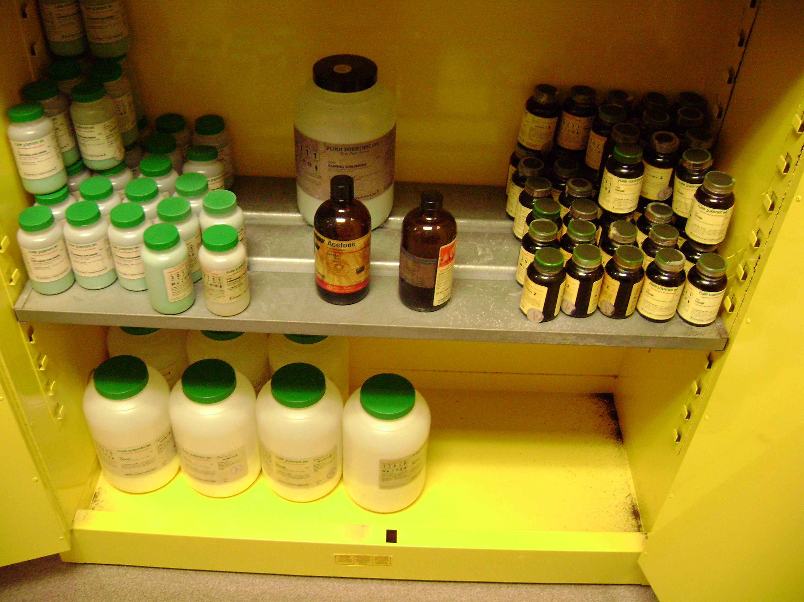
Environmental Compliance & Sustainability
How much regulated and hazardous waste was generated last school year?
5,000 lbs. of hazardous/regulated waste
64,000 gallons of used oil recycled
126,000 fluorescent lamps/ballasts/batteries recycled
How many indoor air quality inspections were performed last school year?
329

Slide 24
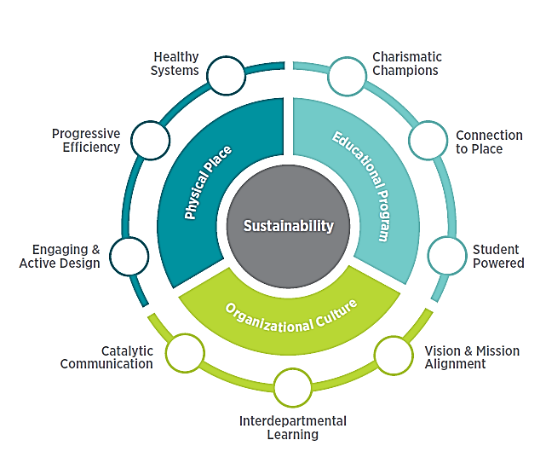
Environmental Compliance & Sustainability

Slide 25
Environmental Compliance & Sustainability
School Year 2022-2023
How much of the waste generated is recycled?
27,262,553 lbs. of the waste stream was recycled
Recycling efforts avoided 35,813 metric tons of carbon dioxide from entering into the atmosphere
Equivalent to the 7,969 passenger vehicles driven for 1 year
More than 4 million gallons of gasoline consumed
Avoided $967,709 in expenditures to the district

Slide 26
Environmental Compliance & Sustainability
Food Waste Reduction
USDA Grant:
2 year pilot at 21 schools
Includes:
Composting
Food Recovery
Food Share Tables
Composting Results:
More than 70,000 lbs. composted since that start of the school year

Slide 27
Environmental Compliance & Sustainability
Renewable Resources
Duke Energy Community Solar Program:
112 Schools powered by solar by June 2024
Orange Technical College – Westside Campus:
Rooftop Solar
Carbon Emissions Baseline
2022-2023 School Year - 339,932 MT CO₂e:
Scope 1 – 7%
Scope 2 – 48%
Scope 3 – 45%

Slide 28
Environmental Compliance & Sustainability

Slide 29
Environmental Compliance & Sustainability

Slide 30
Procurement Services
David Wheeler, Sr. Director

Slide 31
Procurement Services
Procurement and Contracting
Procures all goods and services (non-construction and/or maintenance)
Acquires goods and services utilizing strategic sourcing by way of formal bids, requests for proposals, negotiations, competitive quotes, or any other allowable purchasing methods
Administers and monitors the District Procurement Card Program
Facilities and Construction Contracting
Administers the selection of architectural, engineering, and construction management firms in accordance with the Competitive Consultant Negotiation Act (CCNA)
Prepares and negotiates all contracting documents for the acquisition of services related to design and construction of district facilities
Total Dollar Savings $114,066,722

Slide 32
Procurement Services
Office of Business Opportunity
Manages and monitors the district’s Minority and Woman-Owned Business Enterprise (MWBE), Local Developing Business (LDB), Veteran Business Enterprise (VBE)
Conducts outreach, education, and networking sessions
Monitors sub-contractor relationships
MWBE participation = $117,470,603
LDB participation = $14,291,824
VBE Participation = $816,527

Slide 33
Procurement Services
Courier and Mail Services
Sorts, processes, and delivers inter-office and U.S. mail to schools and offices
Mail Pieces processed through Mail Center = 799,785
Print Services
Responsible for printing district publications and managing district programs for multi-function devices
Jobs Completed = 10,946
Warehouse Operations
Arranges for professional short and long-term storage of materials and equipment needed by many school district departments
Surplus Operations
Picks up and receives salvage equipment and determines appropriate disposition. Recycles received equipment from schools and offices
Cost avoidance through re-use = $2,955,686
E-Waste in pounds = 395,072
Outdated textbook recycling weight in pounds = 1,016,200

Slide 34
Procurement Services
How many purchase orders are processed annually?
28,961
How many active credit cards are throughout the district?
1,387
How much spending was facilitated through Procurement last year?
$1,887,482,522

Slide 35
Procurement Services
OCPS Procurement Services is an award-winning team consistently being recognized as leaders in procurement innovation and industry best practices!

Slide 36
Transportation Services
Bill Wen, Sr. Director

Slide 37
Transportation Services
Transportation is required for students that reside 2 miles or more from their home school
Transports approximately 69,500 students to and from school during the traditional school year. About 57,000 students this year
Transports approximately 3,000 students during the summer for Extended School Year (ESY) intersession, other tutoring programs, and field trips
Facilities are strategically located to reduce miles without students (deadhead miles) to save fuel and be better environmental partners
Operates (4) garage facilities servicing approximately 2,000 district-owned vehicles and equipment
Three bus depots (parking and fueling)

Slide 38
Transportation Facts
Travels over 19.0 million miles annually (Pre-pandemic):
40 round trips to the moon
Now, 13 million miles or 27 round trips to the moon
Employs approximately 1,100 people
Approximately 860 buses on the road daily; covering over 2,700 runs:
2021-2022 – Started school year with 686 bus routes, ended with 618 routes
2022-2023 – Started school year with 548 bus routes
Stops at 13,000 locations twice each day for student pick up
Approximately 20,000 field trips annually

Slide 39
Mission: Keeping Children Safe
US Department of Transportation’s fatality statistics confirm school buses are the safest form of school transportation
Students are about 70 times more likely to get to school safely in a school bus instead of by car
According to the survey from the Council of Great City Schools, OCPS has one of the best safety records among top urban districts in the nation
Buses equipped with GPS and digital surveillance

Slide 40
On-going Challenges After COVID-19
Low unemployment in Central Florida – 3.1% (Oct. 2023):
As low as 2.0% Pre-pandemic and 2.9% one year ago
Private sector offering larger recruiting bonuses
Drivers/monitors – 10-month positions
Jobs with comparable salary with less stress
Fewer people interested in this vocation
Bi-monthly job fairs at bus compounds:
32 job fairs in FY 2022-2023
300 applicants
Under 70 entered driver training
Just over 50 graduated

Slide 41
Transportation Recruiting Efforts Advertisements & Social Media
Job fairs posted on OCPS websites, transportation newsletters and advertisement at all Transportation compounds
Work with Media Relations to promote job fairs (morning news)
Utilize “Now Hiring” business cards
Advertise positions through online sources, i.e., Indeed, Monster, TransitTalent, etc.
Use magnetic “Now Hiring” signs on white fleet vehicles
Targeted on-line ads
Training for non-CDL holders to get CDL

Slide 42
More Than Transporting Students...
Serves as Emergency Support Function (ESF-1) with Orange County Office of Emergency Management
Member of Orange County Community Traffic Safety Team
Member of Student Pedestrian Traffic Safety
Member of SafeWalk
Member of MetroPlan Orlando

Slide 43
More Than Transporting Students...
Works closely with Orange County Sheriff’s Office
Works closely with Orlando Police Department
Work closely with Florida Highway Patrol
Works closely with SAFEKIDS, USA
Works closely with Best Foot Forward

Slide 44
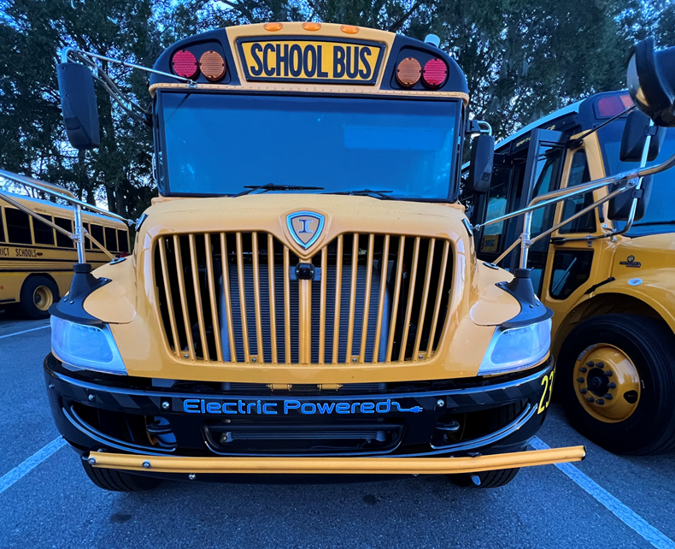
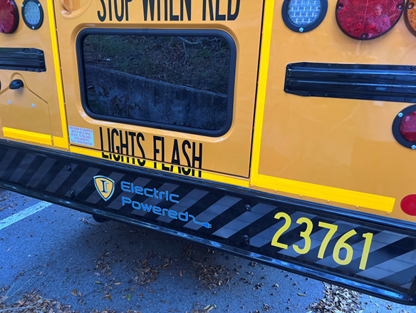
Alternative Fueled Buses
Received Florida Department of Environmental Protection Grant:
The Diesel Emissions Mitigation Program (DEMP) utilizes funds from the Volkswagen Settlement
Funds to offset cost difference between diesel powered buses
Funds to purchase 6 buses and associated charging station costs
First in FL to operate electric school buses daily

Slide 45
Special Needs Training
Kelvin Baker
Manager, Training/Special Needs

Slide 46
Special Needs Training
New drivers and attendants are all certified upon completing the class
Trainees must be able to secure equipment as part of their training:
Wheelchairs
Car seats/rear facing and forward facing
Child’s weight and age is required to determine what type of seat is needed
Star seat/Bessie seat
Arm restraints
Safety vests

Slide 47
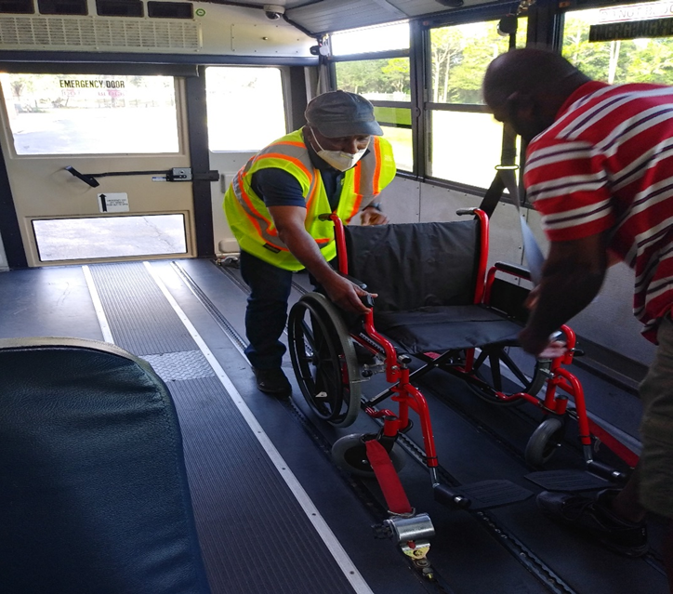
Transportation Training Room

Slide 48
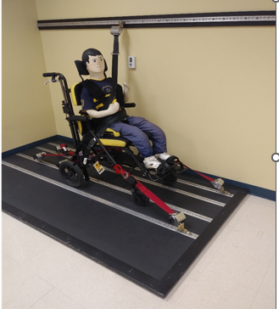
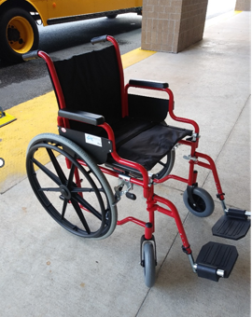
Wheelchairs
Compliant Wheelchair
Non-Compliant Wheelchair

Slide 49
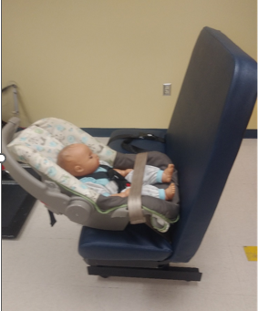
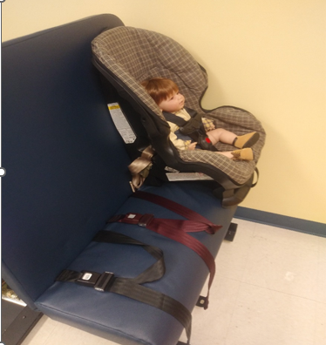
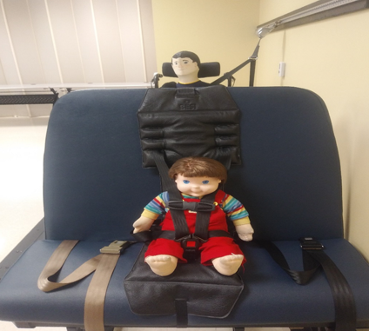
Appropriate Child Safety Restraints

Slide 50
Arm Restraints

Slide 51
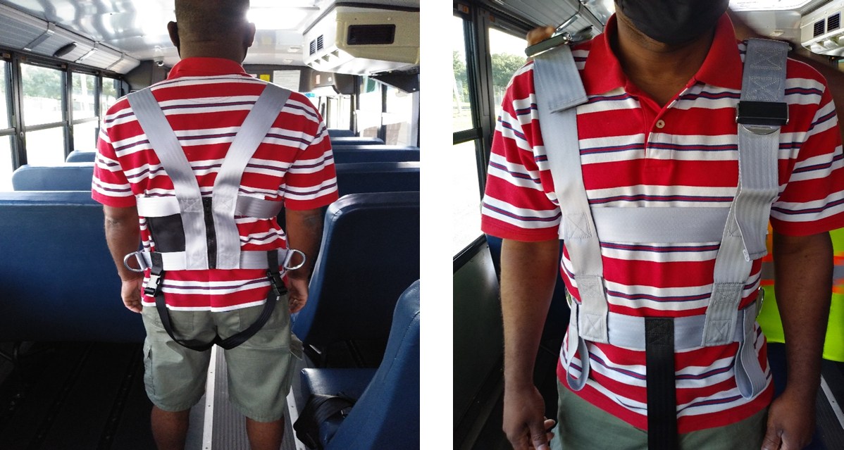
Bus Safety Vests

Slide 52
District Police
Chief Bryan Holmes, Sr. Director

Slide 53
District Police Portfolio
District Police
Communications
Intel
Enterprise Security Systems
Protective Services
Compliance

Slide 54
District Police Strategic Model & Strategies
Strategic Model
Division Priority:
Enhance prevention, intervention and response programs to ensure a safe environment for students and staff
Strategies:
Five total strategies which support the division priority
Projects:
Numerous projects contribute to strategic initiatives
DP Strategies
Reduce prohibited items and weapons in by using safety screening programs
Reduce the presence of illegal substances in the schools

Slide 55
District Police Profile
Established in August 2015
62 authorized full-time staff
23 sworn positions – 11 currently filled
School Resource Officers from 9 partner agencies
Specialized contracts for supplemental law enforcement and security staff

Slide 56
Inaugural Agency Members

Slide 57
Oath of Office Ceremony

Slide 58
Agency Badges and Patch

Slide 59
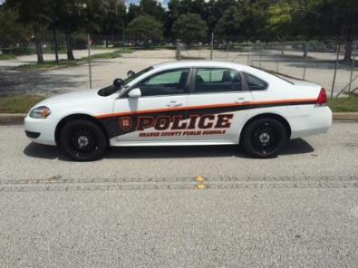
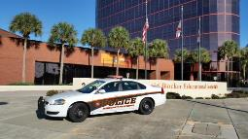
District Police Vehicles

Slide 60
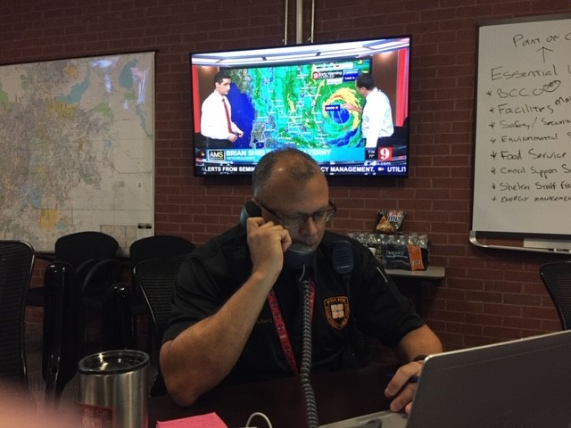
Roles and Responsibilities

Slide 61
District Police Roles and Responsibilities
Chief – District Police, School Safety Specialist is responsible for all school safety and security
Provides direct law enforcement services to district and schools as appropriate
Coordinates on-scene critical incident and emergency response
Conducts training to district personnel on a variety of topics
District Threat Management Coordinator
Coordinating body for law enforcement activities throughout the district

Slide 62
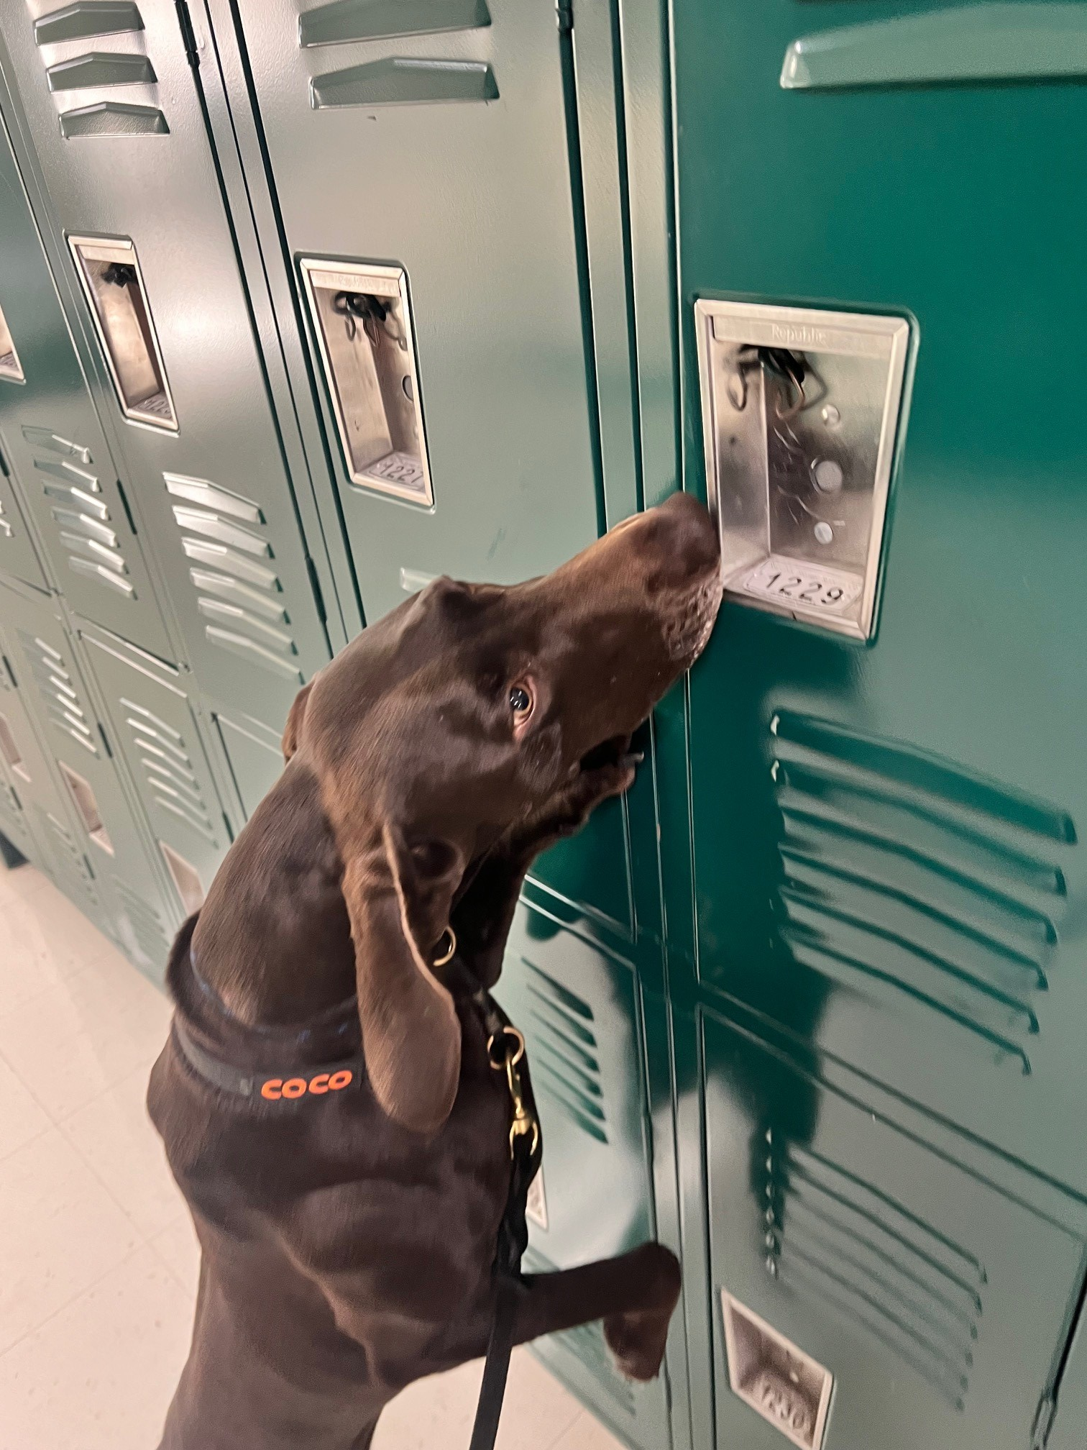
District Police Roles and Responsibilities

Slide 63
District Police Roles and Responsibilities
Establishes all school safety and security protocols for the district
Administers the School Resource Officer (SRO) Program
Collaborates with district and community partners to promote collaborative school safety and security programming focused on prevention and early intervention:
School Justice Partnership Agreement
Other Memorandums of Understanding

Slide 64
Police Communications Roles and Responsibilities
Manage Security Notification system
Answer Emergency Line
Dispatch police and security
Communicate with other law enforcement dispatch centers
24/7/365

Slide 65
District Police Information & Analysis Unit
Manages intelligence information
Conducts threat analysis
Liaisons with other LE intelligence units
Monitors FortifyFL and social media
Supports score card

Slide 66
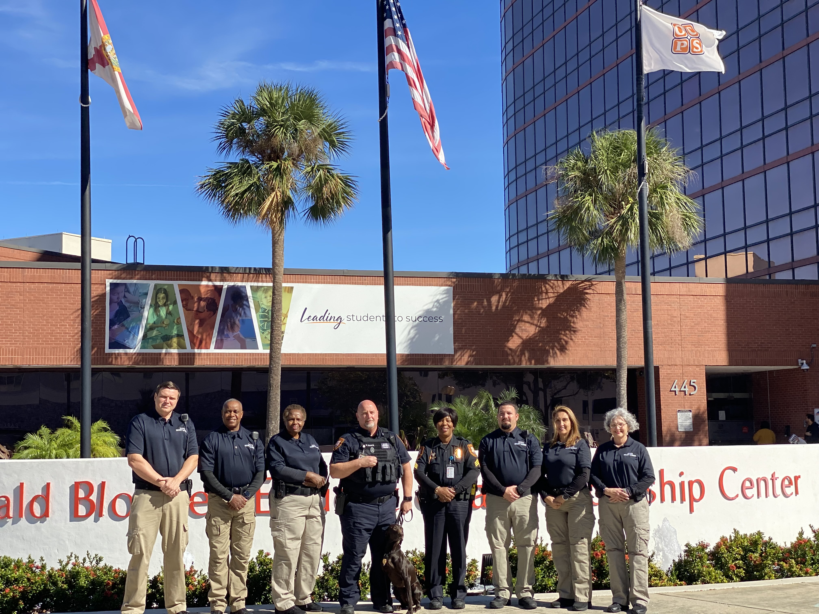
District Police Protective Services Roles and Responsibilities
Facility Security
Alarm Response
Security Incident Reporting
Safety Screenings at Schools and School Board Meetings

Slide 67
Electronic Security Systems Roles and Responsibilities
Support physical and electronic security program
Manages facility access control and camera systems
Supports the Enterprise Visitor Management System
Conducts Intrusion alarm program management
Supports electronic screening program
Supports Alyssa’s Alert – SaferWatch

Slide 68
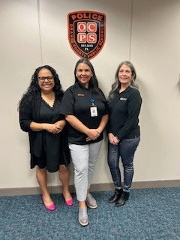
Compliance Roles and Responsibilities
Provides a direct interface with the FDOE Office of Safe Schools
Ensures Marjory Stoneman Douglas High School Public Safety Act compliance and Florida Administrative Code – Rule 6A compliance
Ensures Jeanne B. Clergy Act compliance
Provides oversight and support to the District Threat Management Program

Slide 69
Food and Nutrition Services
Mark Watson, Sr. Director

Slide 70
Food and Nutrition Services
Ensure a maximum number of children participate in the nutrition program – creating equity for readiness to learn​
Healthy children are better students, healthier citizens​
Total meals ​
34 Million in FY23
Record meals served 44 million FY21​
Total breakfasts​
9.6 Million FY23​
Total lunches​
19.8 Million FY23​
194,000 total meals and snacks served per day

Slide 71
Meal Counts – It’s been a ride…
 | Curbside Meals & F2F & Weekend | Face to Face only | Face to Face only
 | FY21 | FY22 | FY23
BREAKFAST | 10,470,829 | 9,537,442 | 9,628,754
LUNCH | 16,232,895 | 21,396,634 | 19,784,745
SNACK | 9,322,910 | 4,151,229 | 3,192,733
SUPPER | 8,642,282 | 2,992,356 | 2,266,595
TOTAL MEALS | 44,668,916 | 38,077,661 | 34,872,827

Slide 72
What’s New? Food and Nutrition Services
Community Eligibility Provision (CEP)
This Provision allows FNS to offer Breakfast and Lunch at No Charge to all OCPS students
First three month of the 2023-24 school year student meal participation has increased:
Breakfast = 7%
Lunch = 16%

Slide 73
Food and Nutrition Services
Self-Enterprise within OCPS​
No district funds​ allocated
FNS pays all costs​ for:
Electricity​
Trash​
Employees​
Food Cost​
Equipment & Repairs​:
Funded by the meals we serve
Funding Sources​

Slide 74
How do children eat?
40% : Daily calories from foods high in fat and sugar
40% : Don’t get enough calcium
20% : One in every five children are food insecure
76% : OCPS Children qualify for free or Reduced Meals
45.7%: Children aged 5 – 11 are obese
100%: Most nutritious meals of the day are in school

Slide 75
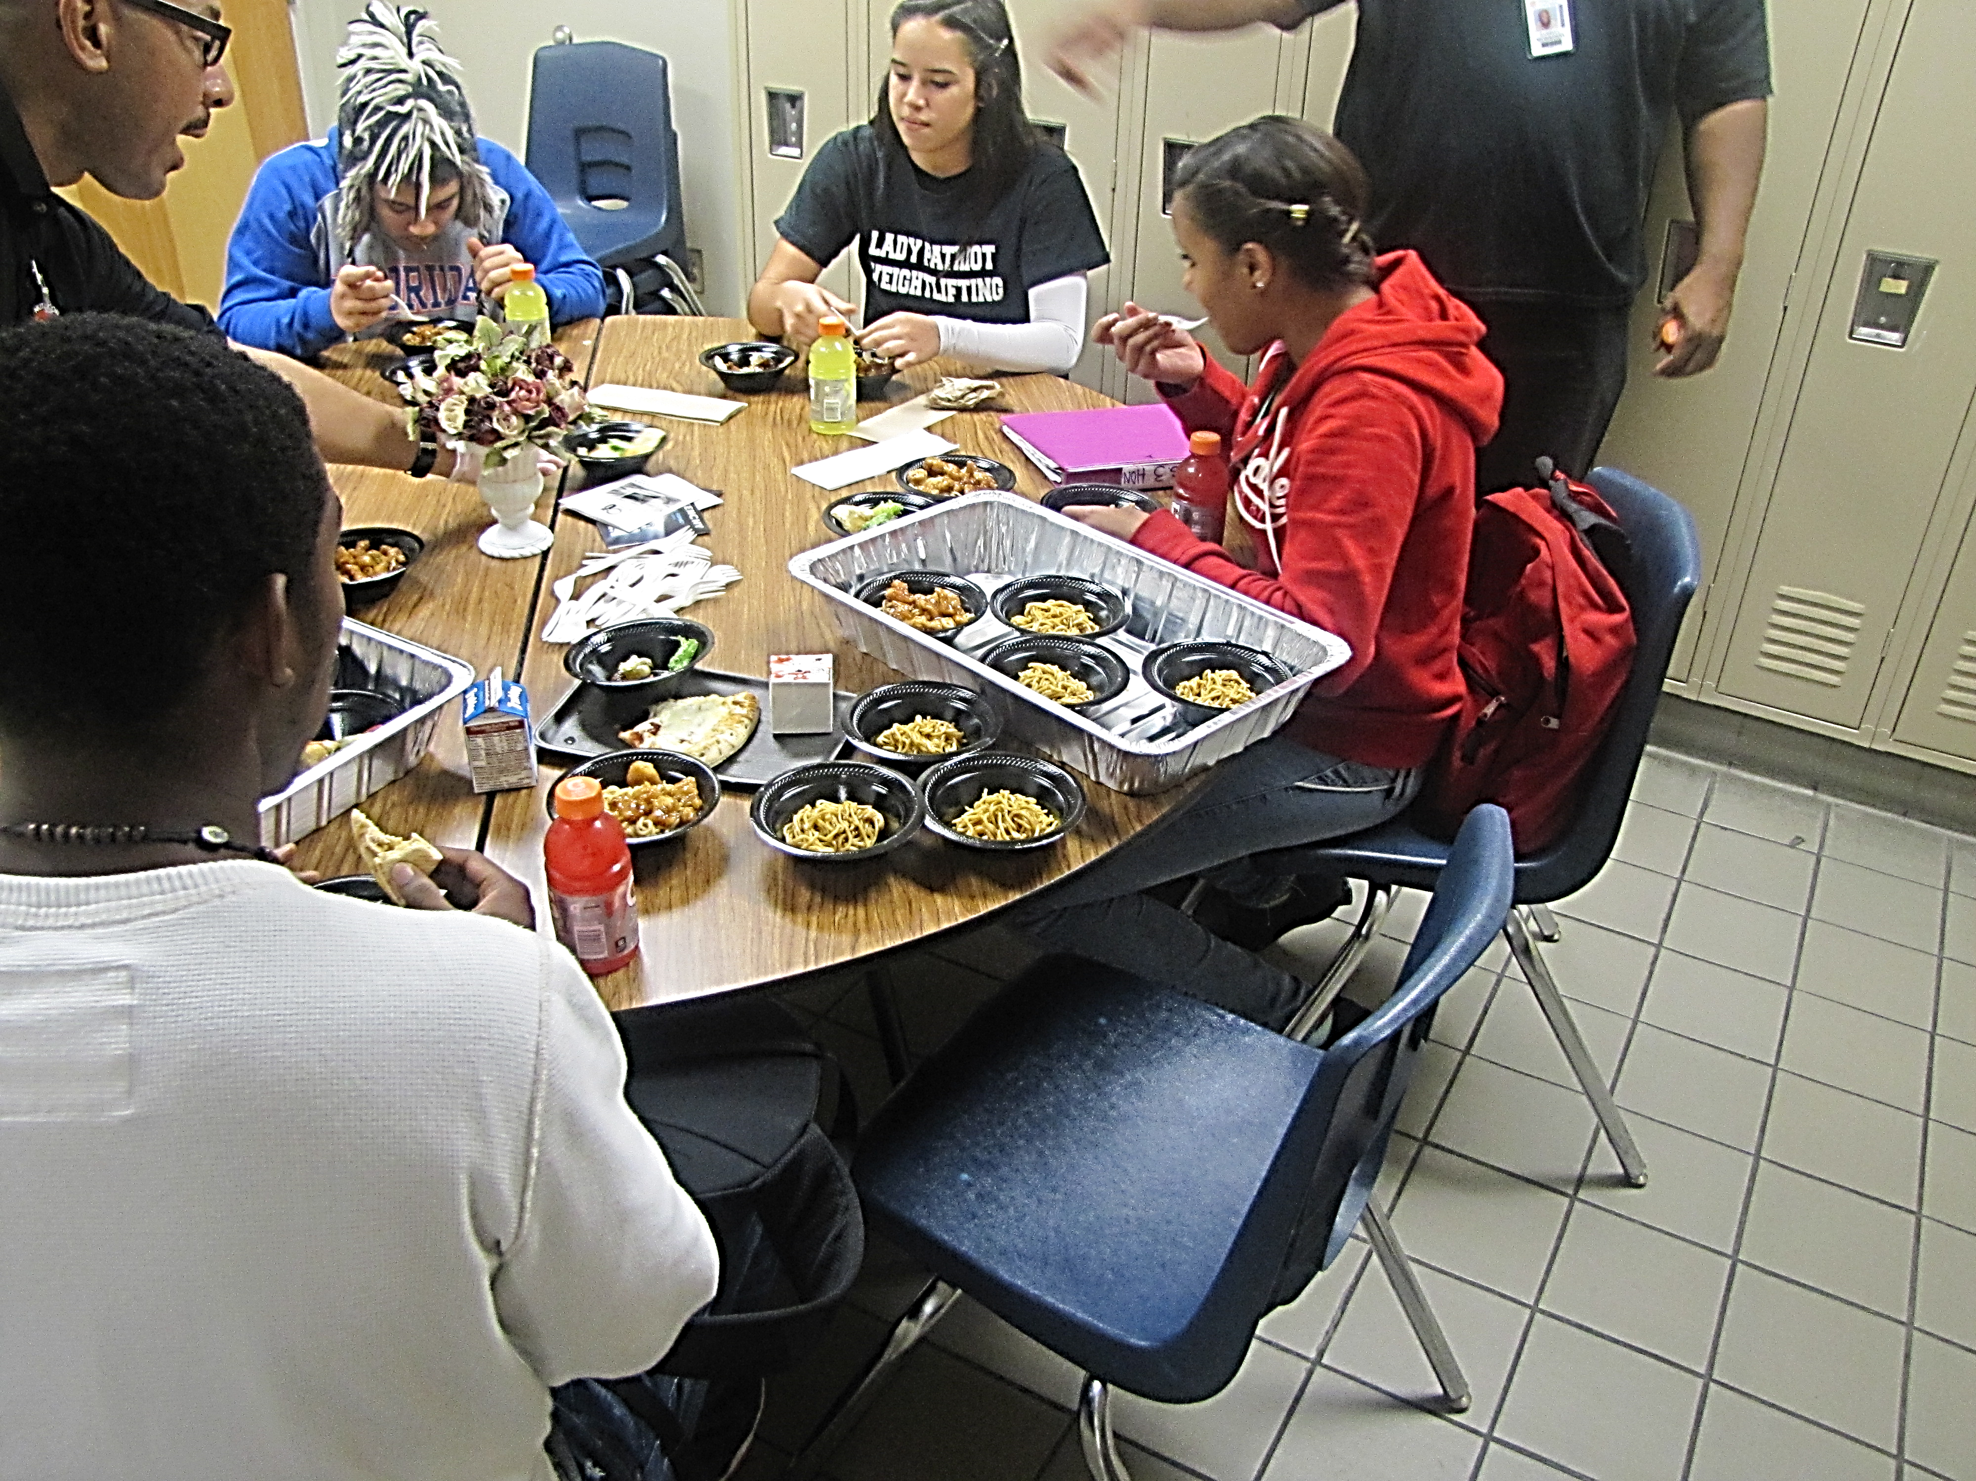
The Heart of Every Food Service... The Menu
Collecting Data

Slide 76
Focus Groups & Food Taste Testing

Slide 77
The Right Menu... Increases Participation
Daily Fresh Produce on Lunch Menus (Mon – Fri)​
Strategy:​
Improve communication between Menu, Procurement and OCPS Produce Vendor​s
Whole produce delivered ​
Introducing fresh produce on daily menus on both Main dishes and Side offerings ​
Emphasis on Fresh From Florida (1x/mo.)​
Focusing on produce in season​

Slide 78
Florida Produce: Farm to School
Corn on the Cob​
Cucumbers​
Green Beans​
Oranges and Satsumas ​
Peppers – yellow and red​
Star Fruit​
Strawberries​
Tangerines​
Tomatoes​
Lettuce and Spinach - Hydroponic

Slide 79
Florida Fresh Produce
Corn from Zellwood ES
Florida Peaches

Slide 80
Fresh Produce Purchased by Pounds

Slide 81
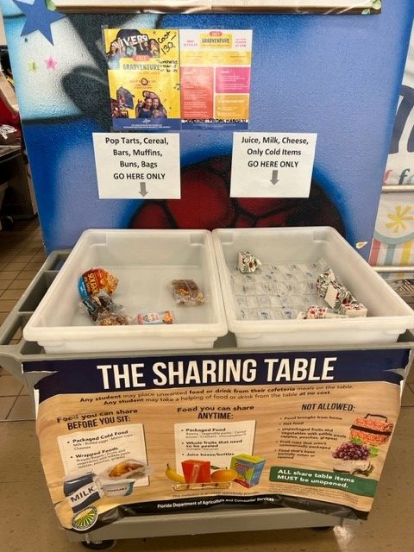
The Sharing Table
Successful at reducing food waste
Allow students to place unwanted items from meal service on a table for another student to consume at no additional charge
Food and beverages are held at 40 degrees Fahrenheit or lower and recorded on a temperature log for the Department of Health
Accumulated leftovers from Share Tables are donated to a registered non-profit agency

Slide 82
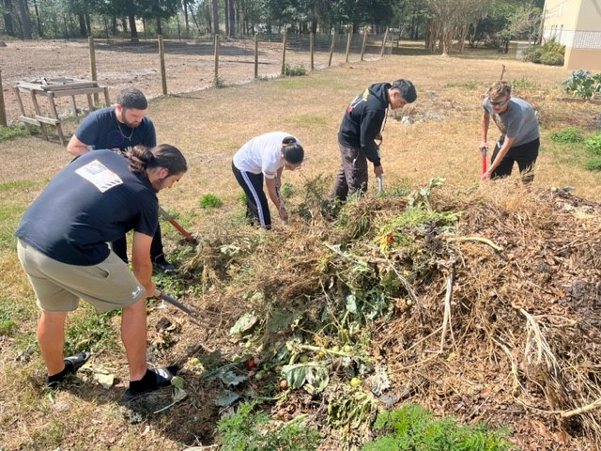
From the Kitchen Cafeteria to Compost
Composting at school is another strategy to lowering food waste
More than 11,000 pounds donated
Food and Nutrition Services supports schools composting by diverting food waste from kitchen production areas

Slide 83
High Performing and Dedicated Team

Slide 84
Culinary Skills
Orange Technical College Culinary
Career Ladder: SFA 3 Position
Culinary Classes

Slide 85
Food and Nutrition Services and Social Media
Results:
Instagram Messages
58,426
Facebook Messages​
19,689​

Slide 86
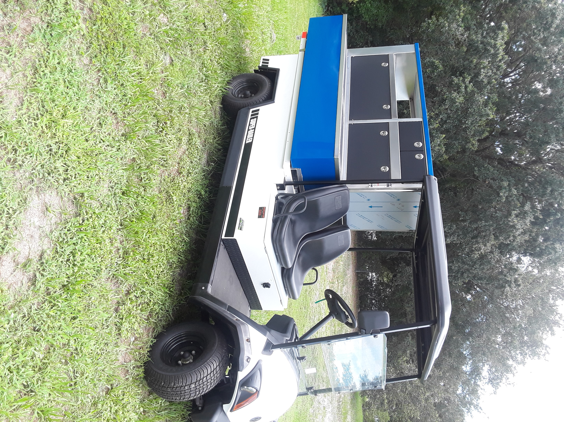
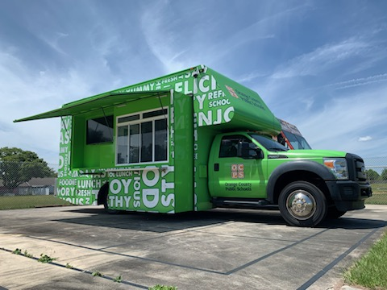
Tools: Golf Cart & Food Truck

Slide 87
The Cost of Food and Labor – 84% of Total Revenue Received
Reimbursement Rate:
Breakfast - $2.73
$1.97 = food and labor cost per plate
Lunch - $4.27
$3.46 = food and labor cost per plate
FY2023: Food costs has increased an average of 16%
Supply Chain: 94% fill rate

Slide 88
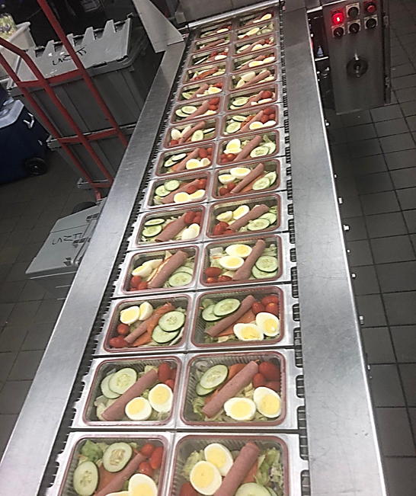
4 Central Kitchens – 56 Schools
Efficiency
Productivity
And
Consistency

Slide 89
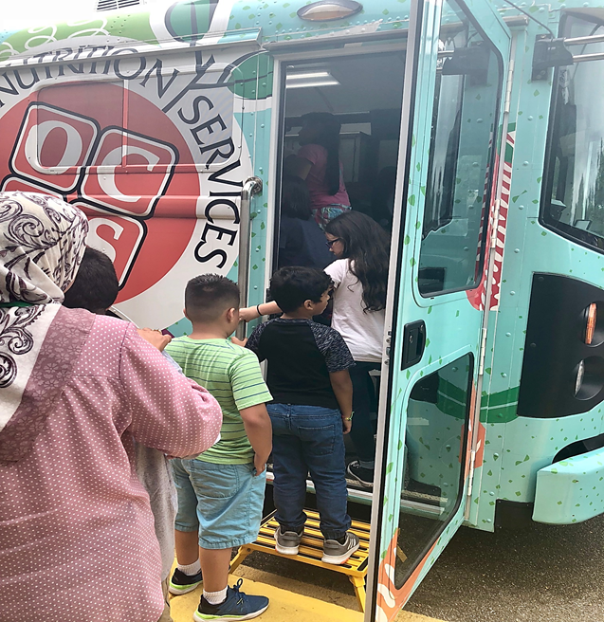
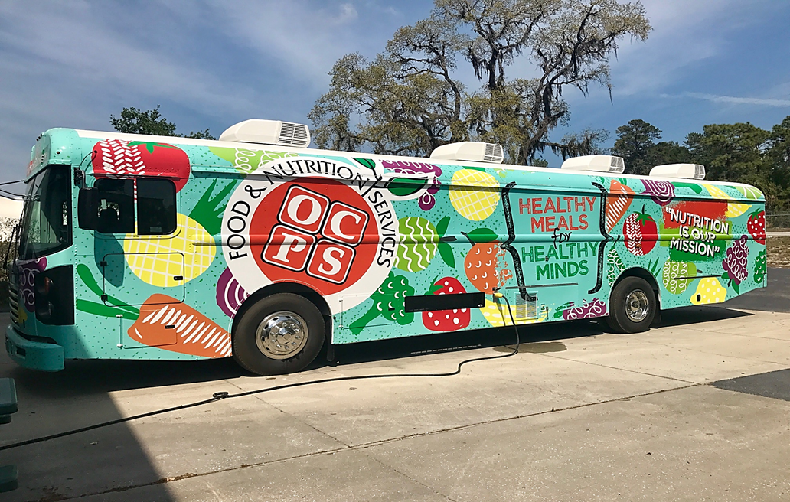
Summer 2023 OCPS Provided Meals to 267 Schools and Community Sites

Slide 90
VISION: To ensure every student has a promising and successful future

